Slide 1
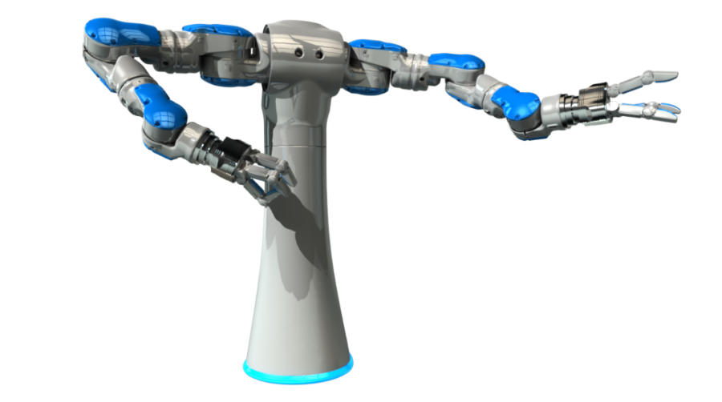
Lesson Planning in the Makerspace Classroom
October 13, 2017

Slide 2
Three-Part Mini-Lesson
Minds On!
Assessing your Prior Knowledge
Action!
Makerspaces & Inquiry-Based Learning
Lesson Planning & Making
Assessment Practices
Consolidation!
Reflection and Next Steps

Slide 3
Minds On: Inquiry, Makerspaces & You
Using your devices, please complete the 1 question poll at this URL: http://bit.ly/2yesPS4
https://PollEv.com/multiple_choice_polls/QboZjkorGckrECF/web

Slide 4
Q: What exactly is Inquiry-Based Learning? A: Inquiry is…
…a dynamic process of being open to wonder and puzzlement and coming to know and understand the world
…a stance that pervades all aspects of life and is essential to the way in which knowledge is created
…based on the belief that understanding is constructed in the process of people working and conversing together as they pose and solve the problems, make discoveries and rigorously test the discoveries that arise in the course of shared activity.
Consider: How does this align with the idea of “making?”
Adapted from www.galileo.org
Notes:
From the website galileo.org
Problem Based- Learning
Project-Based Learning
Passion-Based Learning

Slide 5
Inquiry/”Making” is not…
…a “method” of doing science, math, history or any other subject, in which the obligatory first stage in a fixed, linear sequence is that of students each formulating questions to investigate.
Rather, it is an approach to the chosen themes and topics in which the posing of real questions is positively encouraged, whenever they occur and by whoever they are asked. All tentative answers are taken seriously and investigated as rigorously as the circumstances permit.
Notes:
It will be MESSY

Slide 6
Lesson Planning & Making
Q: I want to incorporate “making” into my lesson. Where do I start?
A: Start where you always do—using Backwards Design
What is the Big Idea?
What do you want your students to know and/or be able to do?
How will you know when they have learned it?
How will you get them there?

Slide 7
Q: Can I see some examples, please?
A: Of course, you can!
http://janettehughes.ca/lab/science-3d-discovery-design-development-through-makerspaces-2/lesson-plans/

Slide 8
Ex. 1: Grade 4 Science: Sound
BIG IDEA: Sound is created by vibrations.
Overall Science and Technology Curriculum Expectations: Students will:
-investigate the characteristics and properties of (light and) sound
Specific Science and Technology Curriculum Expectations: Students will:
3.4 describe properties of sound, including the following: sound travels; sound can be absorbed or reflected and can be modified (e.g., pitch, loudness);
3.5 explain how vibrations cause sound.

Slide 9
Learning Goals and Success Criteria
Learning Goals: We are learning…
To create sound using MakeyMakey
Some of the properties of sound
How sound is caused by vibrations
Success Criteria: We will know we are successful when we…
Get the circuits to create sound
Can describe properties of sound
Can explain how vibrations cause sound

Slide 11
Ex. 2: Grade 8 Science: Cells

Slide 12
Ex. 3: FDK

Slide 13
Ex. 4: Grades 6+: Visual Arts + Writing + Media Literacy

Slide 14
Ex. 5: Grade 5 Mathematics: Measurement

Slide 15
Q: How do I assess the work my students do in the makerspace?
A: Assessment Practices in the Makerspace Classroom should…
be part of an ongoing process vs. a set of isolated events
focus on both process and product
provide descriptive feedback & opportunities for students to self-assess, peer-assess and revise their work
include multiple sources of evidence, formal and informal
provide opportunities for students to show what they know, understand and can do
provide opportunities for students to work and learn together
(Adapted from Focus on Learning, Alberta Learning, 2004)
Notes:
ST—refer to page 30 from IQ book which is in the handout—setting up assessment and questions that go with it etc.—PUT IN HANDOUT
Other assessment tools in handout as well

Slide 16
How do Teachers Collect their Assessment Information?
https://123alexmuir.wordpress.com/2014/12/13/thinking-routines/
Notes:
ST
—Triangulation of Data—more reliable and deeper understanding of student achievement, knowledge and skills developed through the inquiry process—not limited to the final product but also the process.

Slide 17
Consolidation: Reflection and Next Steps
Please post your responses on the linoit at this URL:
http://bit.ly/2yenNFa (Session #1)
http://bit.ly/2hED9ZE (Session #2)
With respect to “Making…”
One thing I feel confident about implementing in my classroom:
One thing that I’m still wondering about:

Slide 18
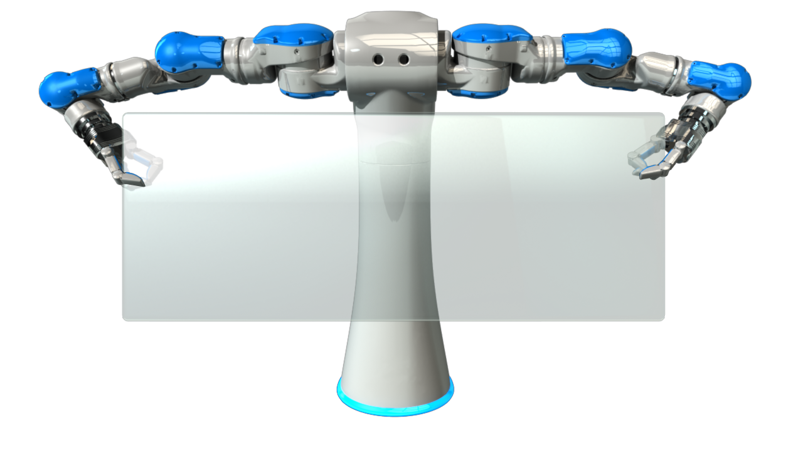
“Give the pupils something to do, not something to learn; and the doing is of such a nature as to demand thinking…learning naturally results.” (J. Dewey)

