Slide 1
Welcome to Programmable Robots
BEd Maker Day
October 13, 2017

Slide 2
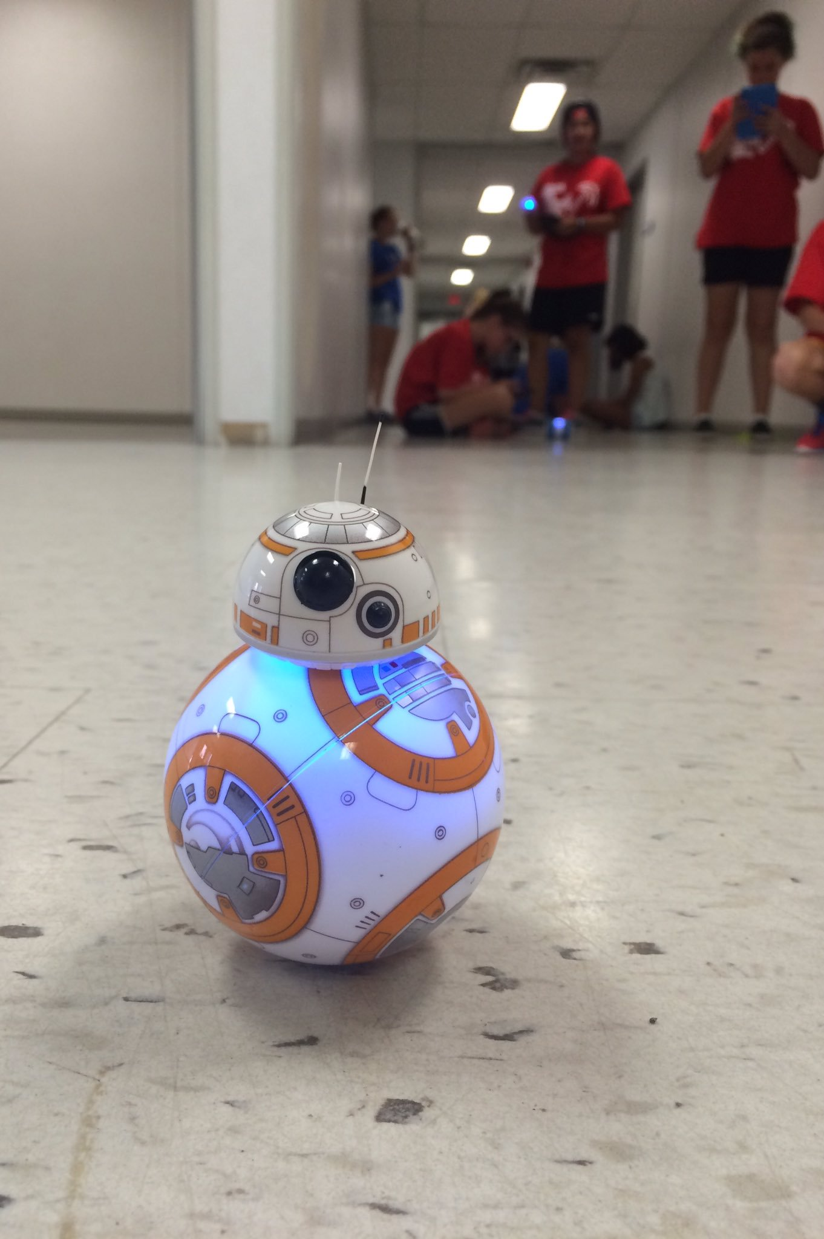
What Do You Know?
Do any of you know anything about programmable robots?
How you seen any robots in your practicum schools?

Slide 3
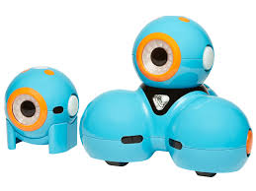
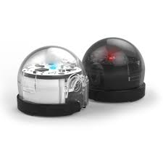
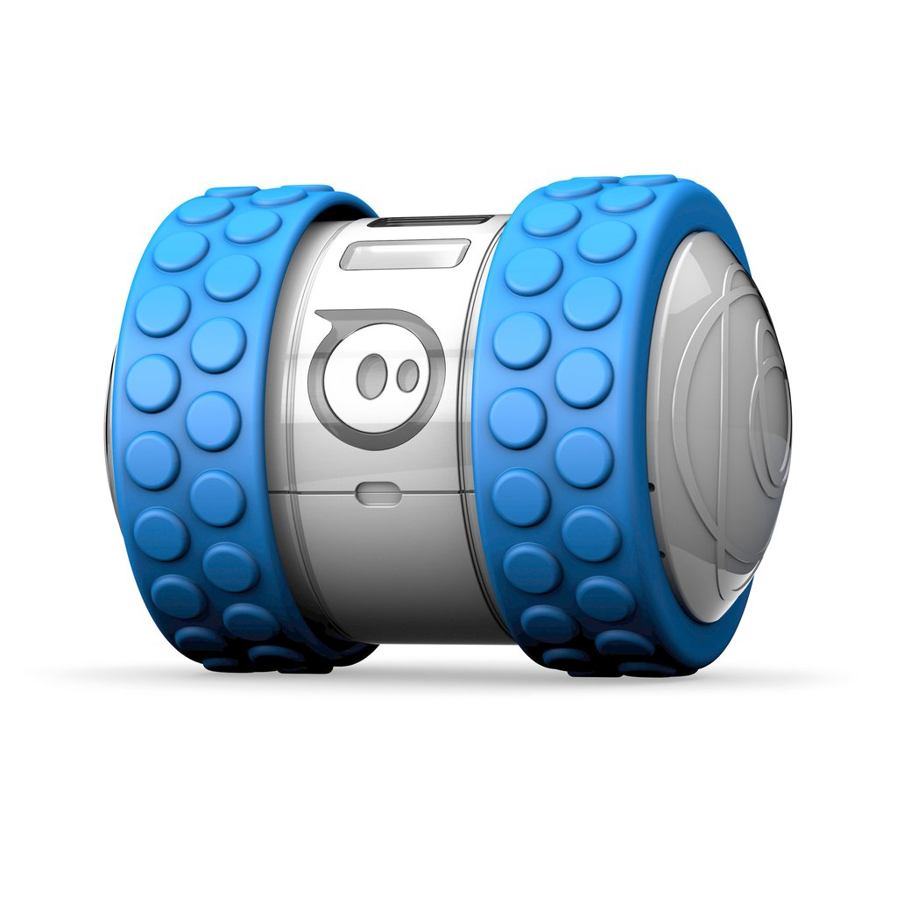
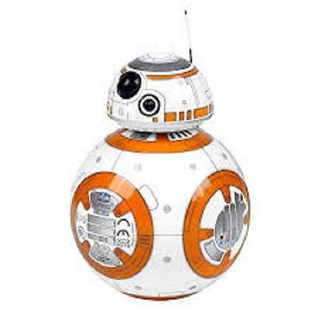
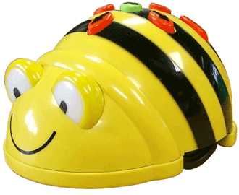
Types of Programmable Robots
Sphero 2.0 + SPRK
Dash & Dot
BB8
Ollie
Ozobot
Beebot

Slide 4
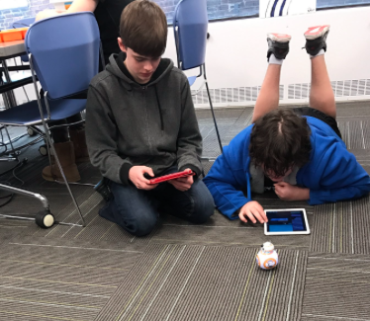
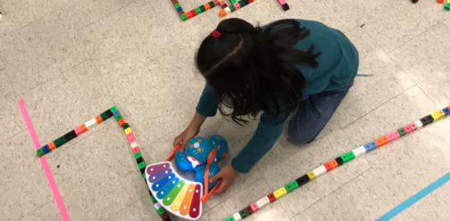
Skills Gained from Programmable Robots
Some of the skills that are developed when students engage with programmable robots are -
Sequential Thinking
Estimation Skills
Judgment and Decision Making
21t Century Skills
Communication
Critical Thinking
Problem Solving
Collaboration

Slide 5
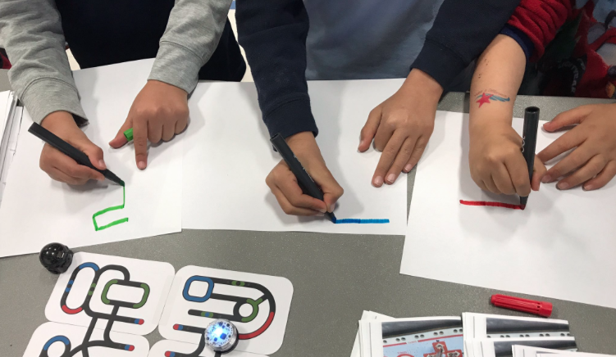
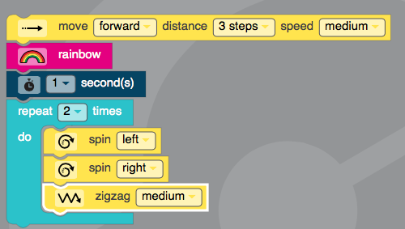
OzoBots
Colour sensing robot that follows a marker line & can read marker colour combinations to “do” something.
Follows the colours - Black, Red, Blue, and Green
The Ozobot are precoded to recognize certain colour combinations.
Ozoblocky.com - a website that takes the Ozobots
capabilities ever further by allowing the user to
program the Ozobot via drag and drop coding.

Slide 6
Sphero, Ollie, Dash and BB8
These 4 robots are programmable robots that are programmed used drag and drop coding through various apps, such as Tickle and Sphero EDU (both are free!)
Tickle can be connected to the Sphero 2.0 (older edition),
Ollie, Dash and BB8. They connect via Bluetooth
Sphero EDU connects to the Sphero Sprk+ (newer edition).
They connect via Bluetooth

Slide 7
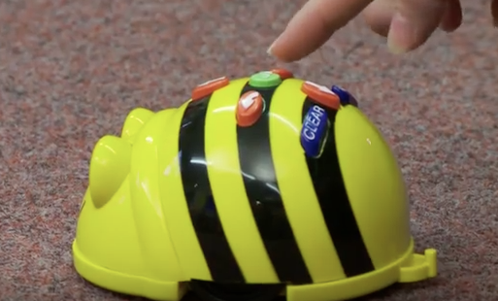
BeeBot
Great robot to introduce students to basic coding and sequential thinking! Perfect for the K - 3 grades
Lights up and makes sounds which is even more engaging for students
Relies more on the sequential thinking aspect, rather than actual coding. To program the BeeBot,
the user simply presses the up, down, left and right arrows to make
the bot move. Note - if you want your BeeBot to turn, only press
the left or right arrow button once.

Slide 8
Math Connections - Overall Expectations There are more
Grade 1 - Number Sense and Numeration → Solve problems involving the addition and subtraction of single-digit whole numbers, using a variety of strategies
Grade 2 - Measurement → Estimate, measure, and record length, perimeter, area, mass, capacity, time, and temperature, using non-standard units and standard units
Grade 3 - Geometry and Spatial Sense → Identify and describe the locations and movements of shapes and objects
Grade 5 - Number Sense and Numeration → Read, represent, compare, and order whole numbers to 100000 & decimal numbers to hundredths
Grade 6 - Measurement → Determine the relationships among units and measurable attributes, including the area of a parallelogram, the area of a triangle, and the volume of a triangular prism
Grade 4 - Measurement → Determine the relationships among units and measurable attributes, including the area and perimeter of rectangles
Grade 7 - Patterning and Algebra → Represent linear growing patterns (where the terms are whole numbers) using concrete materials, graphs, and algebraic expressions
Grade 8 - Geometry and Spatial Sense → Develop geometric relationships involving lines, triangles, and polyhedra, and solve problems involving lines and triangles
Grade 9D - Measurement and Geometry → solve problems involving the measurements of two-dimensional shapes and the surface areas
Grade 10D - Analytic Geometry → Verify geometric properties of triangles and quadrilaterals, using analytic geometry
Grade 9A - Measurement and Geometry → Solve problems involving the measurements of two-dimensional shapes
Grade 10A - Measurement and Trig → verify, through investigation, properties of similar triangles

Slide 9
Time for hands-on learning!!
Break off into 3 groups - you will still need to partner up, or create even smaller groups when using the robots
There will be 3 stations - 12 minutes at each station
Beebots
Programmable Robots → Sphero, Ollie, Dash and BB8
Ozobots
When at each station, start to think of how you would use the tech at hand with your own students in your practicum during a math lesson! How do you see the robots connecting to the math? How do they fit in? How do they benefit the lesson/learning that is taking place?

